Slide 1

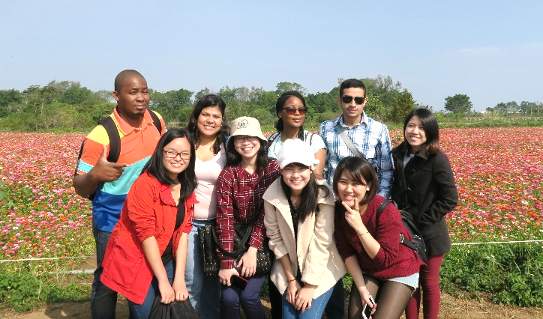

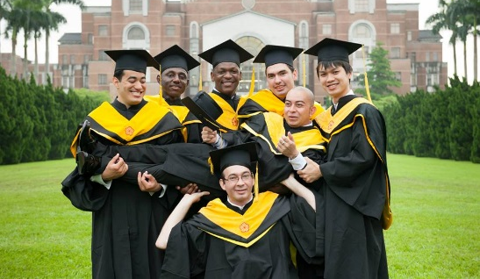
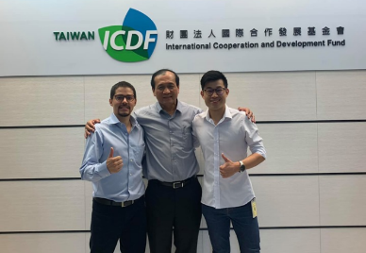
International Master’s Program in
Agricultural Economics
National Taiwan University

Slide 2

Why NTU
Taipei, the capital of Taiwan, is one of the most unique cities in the Chinese speaking world. It is not only for its 400-year history, but also for its modernity, democracy and free atmosphere. The city combines rich traditions with advanced technology and thoughts. It is a city that merges eastern and western culture. In this conflict and harmony, Taipei shows its charm, vitality and diversity. For students who choose Taipei to carry out their study, they will learn to be more intercultural sensitive by living in such a multicultural and dynamic city.
As one of the most prestigious and comprehensive universities in Taiwan, NTU plays an important role in developing Taipei, Taiwan and the people. NTU has been an incubator for top intellectuals, outstanding scholars and excellent researchers in every field in Taiwan.

Slide 3

NTU—Past, Present and Future
National Taiwan University (NTU) was founded by the Japanese in 1928 as Taihoku (Taipei) Imperial University. After World War II, the ROC government resumed the administration of Taihoku Imperial University, reorganized it and renamed it “National Taiwan University” in 1945.
Currently, the university has 11 colleges, 54 undergraduate departments, and 99 graduate institutes offering 98 Master and 88 PhD programs. The number of international students is more than 600, coming from more than 50 different countries all over the world. NTU is actively expanding its international intake, extending more partnerships with top universities in the world, and increasing cooperation in the areas of student exchange, faculty exchange, and dual degree programs.

Slide 4

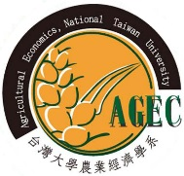
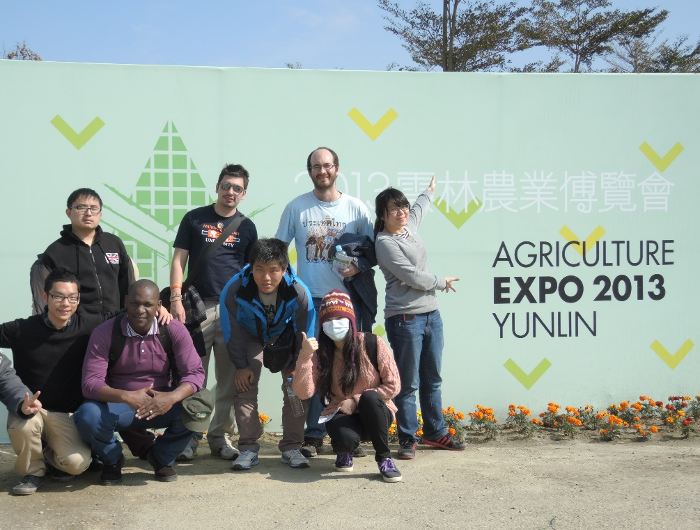
Master Program in Agricultural Economics
The Agricultural Economics Master’s Program is a multifaceted effort of the Department of Agricultural Economics, the College of Bio-Resources and Agriculture, National Taiwan University and Taiwan International Cooperation and Development Fund (TaiwanICDF).
Agricultural development is the crucial factor for a country’s broad-based development. The unique experience of agricultural development in Taiwan can be used as a reference and model for developing countries.
Students learning agricultural economics expertise and agri-business management skills throughout the program will be well prepared to engage in agricultural production, marketing, important issues and problems of agriculture, which in turn helps foster their potential for leadership in agricultural policy and agribusiness management.

Slide 5

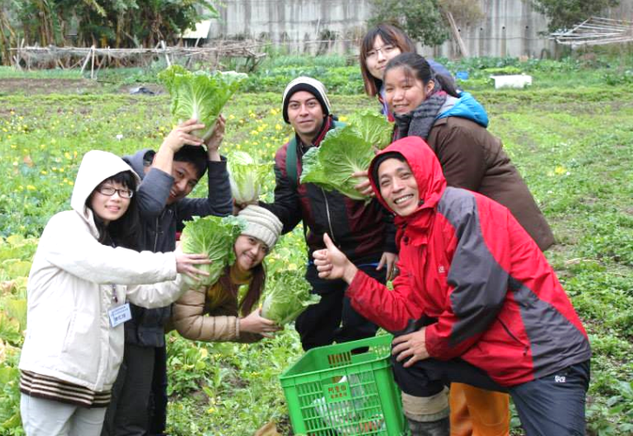
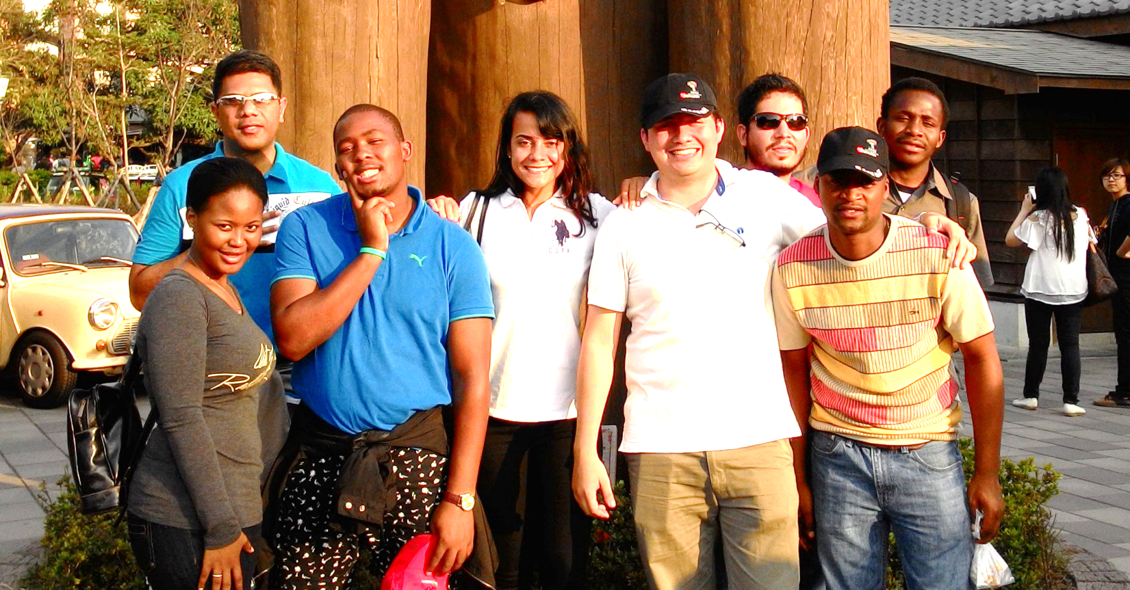
Program Objectives
Enhance international students’ grasp of important issues in agriculture, and to help foster their potential for leadership in agricultural policy and agribusiness management.
Cultivate superior agricultural policy-makers and managers.
Enhance international cooperation and internationalization.

Slide 6
Scope of Curriculum
The curriculum is grouped into four major categories:
Courses | Credits
Applied Microeconomics | 3
Advanced Macroeconomics | 3
Quantitative Methods | 3
Agricultural Policy Analysis | 3
Agricultural Development | 3
Agribusiness Management | 3
Elective Courses | 6 or more
Thesis | -
Agricultural Policy
Institutions and Regulations
Agricultural Marketing
Trade and Consumption
Students are required to complete at least 24 credits, including 18 credits of required courses and at least 6 credits of elective courses offered by the department.

Slide 7

Qualification
Applicants must hold a bachelor’s degree in fields related to Agricultural Economics at foreign universities and colleges approved by the Taiwan Ministry if Education.
Applicants are expected to be equipped with basic mathematics and calculus concepts; also applicants should have Economics and Statistics prerequisite.
Applicants from countries where English is not the official language or those who have completed their bachelor’s degree at a non-English speaking academic institution, is required to take TOEFL or provide English-proficiency verifications.

Slide 8

Admission
APPLY NOW! at BOTH Online Application System below
Step 1: Aug 2019- 14th Feb. 2020- Apply the program through Office of International Affairs, NTU
http://www.oia.ntu.edu.tw/study-at-ntu/degree-student/202021-admission
Step 2: Jan. 2020- Feb. 2020- Apply the Taiwan ICDF Scholarship
http://www.icdf.org.tw/TSP/Welcome.aspx
Documents Required:
      Highest degree diploma
      Highest degree transcript or study record
      Proof of language proficiency (if applicable)
      Photocopy of passport(s) (if available)
      Photocopy of ROC Alien Resident Certificate (if available)
      Financial statement
      Declaration form and Authorization form
      Receipt of application fee
      2 Recommendation Letter(s) (The letter should be written in English and is preferred in A4 size)
      Study plan (Study plan should be written in English and is preferred in A4 size)

Slide 9

Frequently asked questions
Do I need to provide Financial Statement?
  To provide Financial Statement during application is a policy from Ministry of Education of the Republic of China (Taiwan), please upload the financial statement as the application system required. If the bank account is not under your name or has insufficient funds, a financial statement with a signed guarantee of financial support is necessary.
And for Application Fee?
  If you are applying for TaiwanICDF Scholarship, please download your blank Domestic Payment Form (for payment within Taiwan) file and send it to this e-mail agecimp@agec.ntu.edu.tw we will proceed to the following steps.

Slide 10


Contact Information
Department of Agricultural Economics,
National Taiwan University
No. 1, Section 4, Roosevelt Road, Da’an District,
Taipei 106, ROC Taiwan
Contact: Mr. Alan Wu
E-mail: agecimp@agec.ntu.edu.tw
http://oia.ntu.edu.tw/ (Study at NTU > Degree Student > 2020/2021 Admission)
http://www.agec.ntu.edu.tw/inter/super_pages.php?ID=inter1
https://www.facebook.com/impagec
TEL: 886-2-3366-2674
FAX: 886-2-2362-8496

